Slide 1
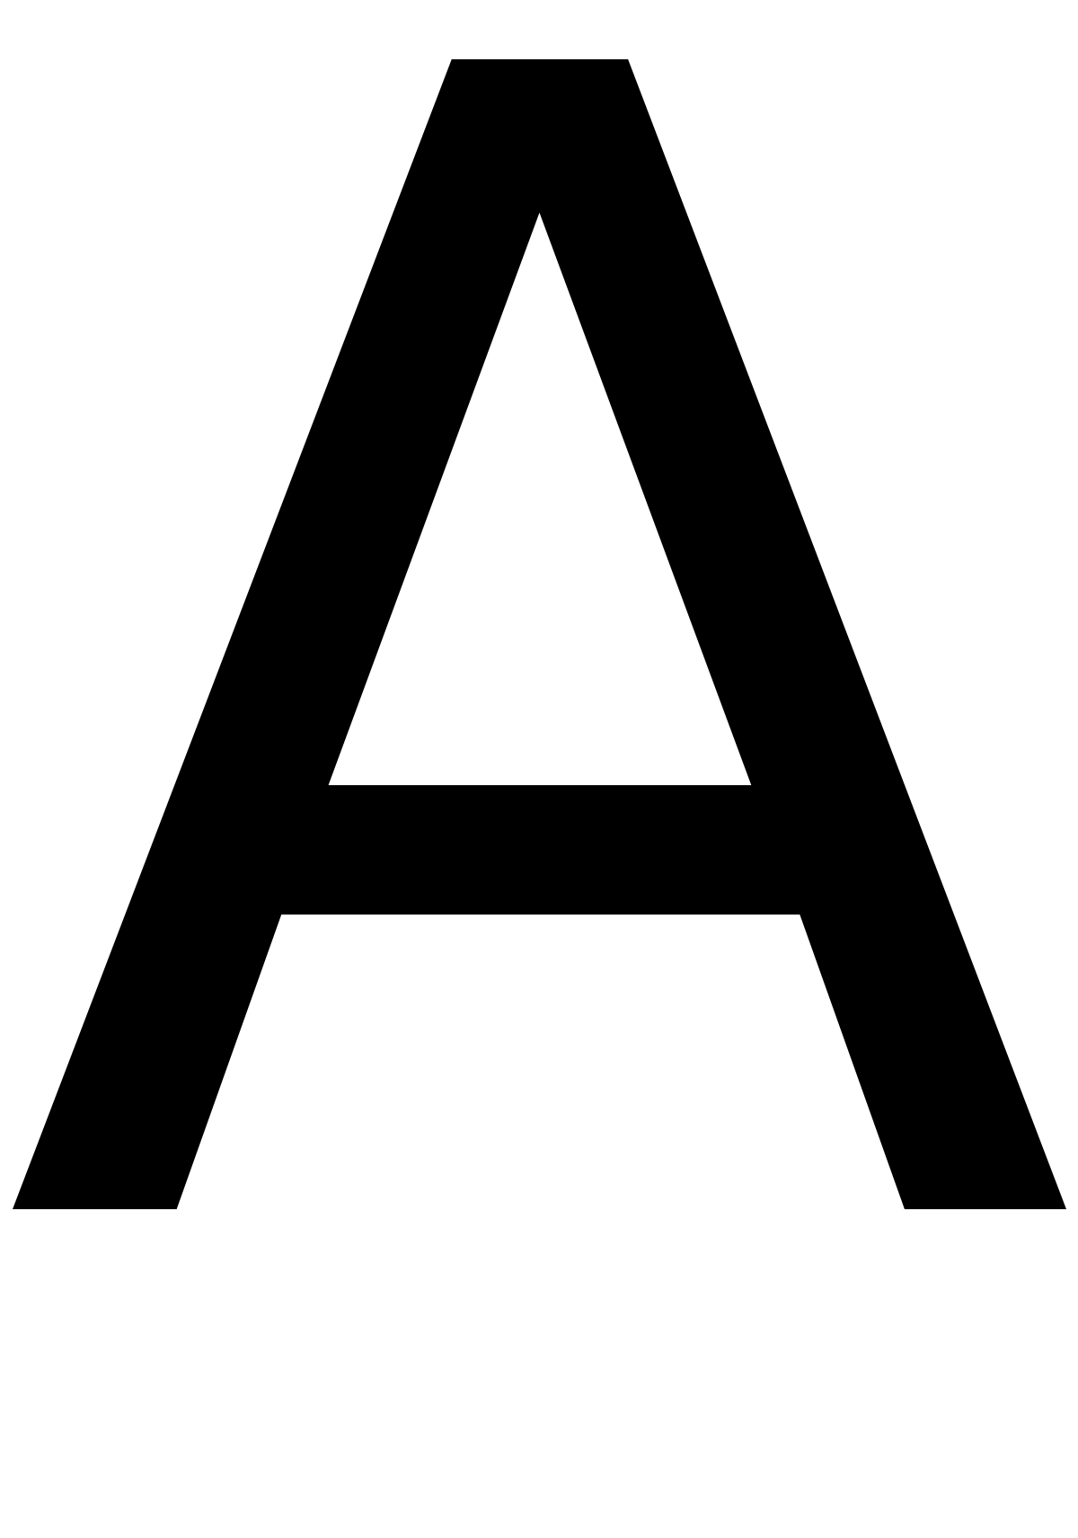
a
A, or a, is the first letter and the first vowel of the modern English alphabet.
Its name in English is a.

